Slide 1
Unit-3
Learning Theory and Model Evaluation
Prepared By: Arjun Sing Saud
Asst. Prof. CSCSIT, TU

Slide 2
Bias Variance Tradeoff
The prediction error for any machine learning algorithm can be broken down into three parts:
Bias Error
Variance Error
Irreducible Error
The irreducible error cannot be reduced regardless of what algorithm is used. It is the error introduced from the chosen framing of the problem and may be caused by factors like unknown variables that influence the mapping of the input variables to the output variable.

Slide 3
Bias Variance Tradeoff
Bias is the difference between the average prediction of our model and the correct value which we are trying to predict.
Model with high bias pays very little attention to the training data and oversimplifies the model. It always leads to high error on training and test data.
Bias is the tendency of an estimator to pick a model for the data that is not structurally correct. For example, suppose that we use a linear regression model on a cubic function.

Slide 4
Bias Variance Tradeoff
Bias is caused by underfitting and is the result of simplifying assumptions made by a model to make the target function easier to learn.
Variance is taken as the variability of a model prediction for a given data point.
Model with high variance pays a lot of attention to training data and does not generalize on the data which it hasn’t seen before.
As a result, such models perform very well on training data but has high error rates on test data. Variance is the result of overfitting.

Slide 5
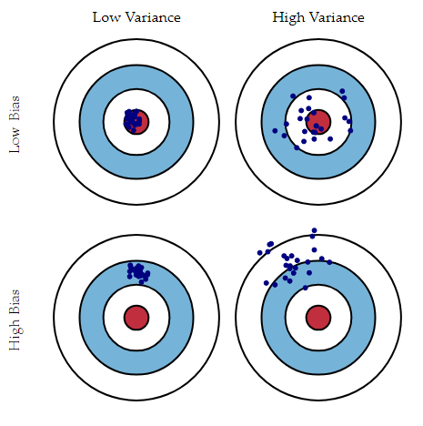
Bias Variance Tradeoff
Variance is error from sensitivity to small fluctuations in the training set. High variance can cause an algorithm to model the random noise in the training data, rather than the intended outputs

Slide 6
Bias Variance Tradeoff
If our model is too simple and has very few parameters then it may have high bias and low variance.
On the other hand if our model has large number of parameters then it’s going to have high variance and low bias. So we need to find the right/good balance without overfitting and underfitting the data. This keeps the MSE minimal.

Slide 7
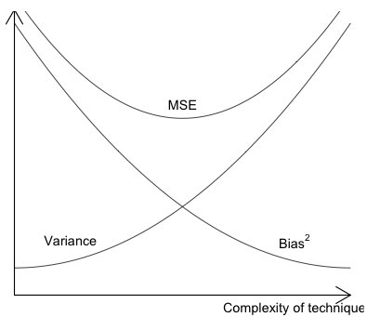
Bias Variance Tradeoff
Error

Slide 8
Cross-Validation
Cross-validation is a re-sampling procedure used to evaluate machine learning models on a limited data sample.
k-Fold Cross-Validation (Muti-Fold Cross-Validation) is widely used for cross validation. If we choose k=10, it becomes 10-fold cross validation.
In this approach, the original sample is randomly partitioned into k equal sized subsamples. Out of the k subsamples, a single subsample is used as the testing set, and the remaining k − 1 subsamples are used as training set.

Slide 9
Cross-Validation
The cross-validation process is then repeated k times, with each of the k subsamples used exactly once as the testing data. The k results can then be averaged to produce a single estimation.
The advantage of this method is that all observations are used for both training and testing, and each observation is used for testing exactly once. 10-fold cross-validation is commonly used, but in general k remains an unfixed parameter.
For example, setting k = 2 results in 2-fold cross-validation.

Slide 10
Cross-Validation
In 2-fold cross-validation, we randomly shuffle the dataset into two sets d₀ and d₁, so that both sets are equal size. We then train on d₀ and test on d₁, followed by training on d₁ and testing on d₀.
To make the cross-validation procedure concrete, let’s look at a worked example. Imagine we have a data sample with 6 observations: {(1,3), (2,5), (3,7), (4,9), (5,11), (6,13)}
Let k=3. That means we will shuffle the data and then split the data into 3 groups:

Slide 11
Cross-Validation
Fold 1= {(1,3),(5,11)}
Fold 2= {(6,13),(3,7)}
Fold 3= {(2,5),(4,9)}
Three models are trained and evaluated with each fold given a chance to be the held out test set. For example:
Model 1: Trained on Fold 1 + Fold 2, Tested on Fold 3
Model 2: Trained on Fold 2 + Fold 3, Tested on Fold 1
Model3: Trained on Fold 1 + Fold 3, Tested on Fold 2

Slide 12
Performance Measures of Classification
Before selecting a classification algorithm to solve a problem, we need to evaluating its performance. Confusion matrix is widely used for computing performance measures of classification algorithm.
A Confusion matrix is an N x N matrix used for evaluating the performance of a classification model, where N is the number of target classes.
The matrix compares the actual target values with those predicted by the machine learning model. This gives us a holistic view of how well our classification model is performing and what kinds of errors it is making.

Slide 13
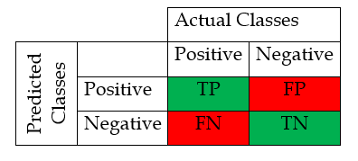
Performance Measures of Classification
For a binary classification problem, we would have a 2 x 2 matrix as shown below with 4 values:
True Positive(TP): It represents correctly classified positive classes. Both actual and predicted class are positive here.

Slide 14
Performance Measures of Classification
False Positive (FP): It represents incorrectly classified positive classes. These are the positive classes predicted by the model that were actually negative. This is called Type I error.
True Negative(TN): It represents correctly classified Negative classes. Both actual and predicted class are negative here.
False Negative (FN): It represents incorrectly classified negative classes. These are the negative classes predicted by the model that were actually positive. This is called Type II error.

Slide 15
Performance Measures of Classification
Four widely used performance measures used for evaluating classification models are: Accuracy, Recall, Precision, F1-score.
Accuracy: It is the percentage of correct predictions made by the model and is given as below:
Precision: It is percentage of predicted positives that are actually positive and is given by:

Slide 16
Performance Measures of Classification
Recall: It is the percentage of actual positives that are correctly classified by the model and is given as below:
F1-score: It is the harmonic mean of recall and precision. It becomes high only when both precision and recall are high. This score is given by:

Slide 17
Performance Measures of Classification
Example
Suppose that we have to classify 100 people as pregnant or not pregnant. This includes 40 pregnant women and the remaining 60 are not pregnant. Out of 40 pregnant women 30 pregnant women are classified correctly and the remaining 10 pregnant women are classified as not pregnant by the machine learning algorithm. On the other hand, out of 60 people in the not pregnant category, 55 are classified as not pregnant and the remaining 5 are classified as pregnant.
Compute accuracy, precision, recall, and F1-score for the above example.

Slide 18
Model Evaluation
Classification Metrics
We shouldn’t use accuracy on imbalanced problems. Then, it is easy to get a high accuracy score by simply classifying all observations as the majority class.
The F1-score is a popular metric for imbalanced classification.

Slide 19
Model Evaluation
Sensitivity-Specificity Metrics
Sensitivity refers to the true positive rate and summarizes how well the positive class was predicted.
Sensitivity=Recall = TP / (TP + FN)
Specificity is the complement to sensitivity, or the true negative rate, and summarizes how well the negative class was predicted.
Specificity = TN / (FP + TN)

Slide 20
Model Evaluation
ROC Curve
ROC curve is a plot of true positive rate against false positive rate. ROC stand for receiver operating characteristics.
True positive rate is also called and recall and is give by:

Slide 21
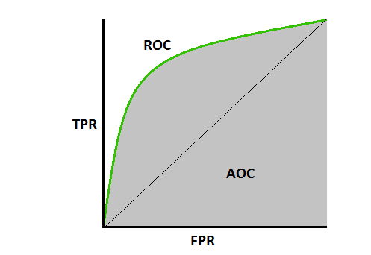
Model Evaluation
ROC Curve
If area under the ROC curve is higher, the better is the model performance.
If the curve is somewhere near the 50% diagonal line, it suggests that the model randomly predicts the output variable.

Slide 22
Model Evaluation
Log Loss
Log loss is a very effective classification metric and is equivalent to -1* log (likelihood function) where the likelihood function suggests how likely the model thinks the observed set of outcomes was.
Since the likelihood function provides very small values, a better way to interpret them is by converting the values to log and the negative is added to reverse the order of the metric such that a lower loss score suggests a better model.

Slide 23
Model Evaluation
Regression Metrics
Regression models provide a continuous output variable, unlike classification models that have discrete output variables. Therefore, the metrics for assessing the regression models are accordingly designed.
Some of the widely used regression metrics are: MSE, RMSE, RMSLE, MAE, R².

Slide 24
Model Evaluation
Mean Squared Error (MSE)
MSE is a simple metric that calculates the difference between the actual value and the predicted value (error), squares it and then provides the mean of all the errors.
Where y is actual value and is predicted value

Slide 25
Model Evaluation
MSE is very sensitive to outliers and will show a very high error value even if a few outliers are present in the otherwise well-fitted model predictions.
Root Mean Squared Error (RMSE)
RMSE is the root of MSE and is beneficial because it helps to bring down the scale of the errors closer to the actual values, making it more interpretable.

Slide 26
Model Evaluation
Mean Absolute Error or MAE
MAE is the mean of the absolute error values (actuals – predictions).
If one wants to ignore the outlier values to a certain degree, MAE is the choice since it reduces the penalty of the outliers significantly with the removal of the square terms.

Slide 27
Model Evaluation
Root Mean Squared Log Error (RMSLE)
In RMSLE, the same equation as that of RMSE is followed except for an added log function along with the actual and predicted values.
This helps to scale down the effect of the outliers by downplaying the higher error rates with the log function.

Slide 28
Model Evaluation
R-squared (R²)
R-Square measures the proportion of variance of the dependent variable explained by the independent variable.

Slide 29
Model Evaluation
R-squared (R²)
basically R2 squared calculates how must regression line is better than a mean line. Larger R squared value indicates a better fit.
Hence, R2 squared is also known as Coefficient of Determination or sometimes also known as Goodness of fit.
R² score ranges from 0 to 1. The closest to 1 the R², the better the regression model is. If R² is equal to 0, the model is not performing better than a random model.

Slide 30
Model Evaluation
Adjusted R²
The disadvantage of the R² score is while adding new features in data the R² score starts increasing or remains constant but it never decreases because It assumes that while adding more data variance of data increases.
But the problem is when we add an irrelevant feature in the dataset then at that time R² sometimes starts increasing which is incorrect.
Hence, to control this situation Adjusted R Squared came into existence.

Slide 31
Model Evaluation
Adjusted R²
Where, n is number of observations, k is number of independent variables, and is adjusted R²

Slide 32
Model Evaluation
Adjusted R²
Now as K increases by adding some irrelevant features so the denominator will decrease, n-1 will remain constant. R² score will remain constant or will increase slightly so the complete term will increase and when we subtract this from one then the resultant score will decrease.
And if we add a relevant feature then the R² score will increase and 1-R² will decrease heavily and the denominator will also decrease so the complete term decreases, and on subtracting from one the score increases.

Slide 33
Model Evaluation
Clustering Metrics
Clustering algorithms predict groups of data points and hence, distance-based metrics are most effective.
Some of the widely used clustering metrics are Dunn Index, Silhouette Coefficient, Elbow method etc.

Slide 34
Model Evaluation
Dunn Index
The Dunn index (DI) a metric for evaluating clustering algorithms. The aim of this Dunn index to identify sets of clusters that are compact, with a small variance between members of the cluster, and well separated, where the means of different clusters are sufficiently far apart.
It is calculated as the lowest inter-cluster distance (ie. the smallest distance between any two cluster centroids) divided by the highest intra-cluster distance.

Slide 35
Model Evaluation
The Dunn index for c number of clusters is defined as :
Where, is the inter-cluster distance between
clusters. is intra-cluster distance.

Slide 36
Model Evaluation
Higher the Dunn index value, better is the clustering. The number of clusters that maximizes Dunn index is taken as the optimal number of clusters k.
It also has some drawbacks. As the number of clusters and dimensionality of the data increase, the computational cost also increases.

Slide 37
Model Evaluation
Silhouette Coefficient
Silhouette Coefficient or silhouette score is another metric used to calculate the goodness of a clustering technique. Its value ranges from -1 to 1.
Silhouette Score = (b-a)/max(a,b)
where, a= average intra-cluster distance and b is average nearest inter-cluster distance.

Slide 38
Model Evaluation
The best value is 1 and the worst value is -1. Values near 0 indicate overlapping clusters. Negative values generally indicate that a sample has been assigned to the wrong cluster, as a different cluster is more similar.

Slide 39
Model Evaluation
Elbow Method
The elbow method is used to determine the number of clusters in a dataset by plotting the number of clusters on the x-axis against the percentage of variance explained on the y-axis.
The point in x-axis where the curve suddenly bends (the elbow) is considered to suggest the optimal number of clusters.

Slide 40
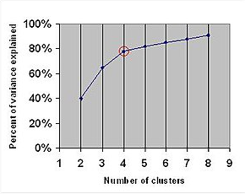
Model Evaluation
The elbow method in these 4 steps:
Run K-means for a range of K's
Calculate the Sum of Squares of the distances (SSD) from the cluster mean
Plot a curve of the SSD over K's
Visually pick the K at the elbow

Slide 41
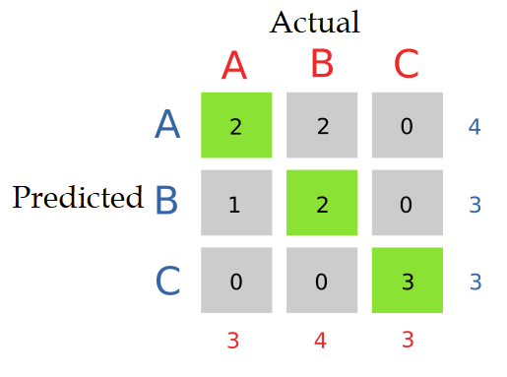
Evaluation Metrics for Multi-class Classification
If there are N number of classes confusion matrix is a NxN matrix. For example, for 3 classes confusion matric looks like below.

Slide 42
Evaluation Metrics for Multi-class Classification
Then we need to calculate TP, FP, TN and FN for each class separately.
TP: Actual and predicted both same.
FP: Sum of all entries in the row except TP.
TN: sum of all entries in rows and columns except row and column of calculating class.
FN: Sum of all entries in the column except TP.

Slide 43
Evaluation Metrics for Multi-class Classification
Example:
For Class A: TP=2, FP=2, TN=5, FN:1
For Class B: TP=2, FP=1, TN=5, FN:2
For Class C: TP=3, FP=0, TN=7, FN:0

Slide 44
Evaluation Metrics for Multi-class Classification
In multi-class classification we calculate accuracy of each class separately and then we calculate weighted average accuracy.
If we assign equal weight to each class then
There are two different ways to calculate Recall.
Macro averaged recall: calculate recall for all classes individually and then average them
Micro averaged recall: calculate class wise true positive and false negative and then use that to calculate overall recall.

Slide 45
Evaluation Metrics for Multi-class Classification
Similarly, there are two different ways to calculate precision.
Macro averaged precision: calculate precision for all classes individually and then average them.
Micro averaged precision: calculate class wise true positive and false positive and then use that to calculate overall precision.

Slide 46
Evaluation Metrics for Multi-class Classification
In the same way, there are two different ways to calculate F1-score.
Macro averaged F1 Score: calculate f1 score of every class and then average them.
Micro averaged F1 Score: calculate micro-averaged precision and recall score and then take their harmonic mean.

Slide 47
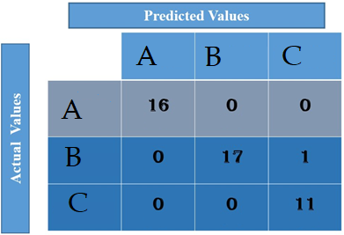
Evaluation Metrics for Multi-class Classification
Example: Consider following confusion matrix and the calculated accuracy, weighted average accuracy and macro and micro precision, recall, and F1-score.

Slide 48
Model Selection
Model selection is the process of selecting one final machine learning model from among a collection of candidate machine learning models for a training dataset.
For selecting best model among the set of candidate models we need to use following technique.
Train/Test Split: We need to divided data into train, validation and test sets and need to evaluate performance of each model.

Slide 49
Model Selection
K-fold cross validation: We need to evaluate performance of models using K-fold cross validation. (Already discussed)
Hyperparameter Optimization: Although the terms parameters and hyperparameters are occasionally used interchangeably, distinctions exist between them. Parameters are properties that the algorithm learns during training. For linear regression, those parameters are the coefficients and biases. For random forests, they're the variables at each node.

Slide 50
Model Selection
Hyperparameter Optimization: Hyperparameters are properties that must be set before training. For k-means clustering, you must define the value of k. For neural networks, an example is the learning rate. Hyperparameter optimization is the process of finding the best possible values for the hyperparameters to optimize performance metric.

